Slide 1
Project for AI-CADEMY
Submitted by : Alisha babar.

Slide 2
Brest Cancer Predection.
Title: Breast Cancer Detection using Machine Learning
Subtitle: A deep learning approach to predict cancerous tumors
Date: 13 feb,2025.

Slide 3
Introduction
Breast Cancer Overview: Breast cancer is one of the most common and leading causes of death among women worldwide. Early detection is crucial for effective treatment and increasing survival rates.
Machine Learning for Early Detection: Machine learning techniques can automate the detection process, offering faster, more accurate predictions based on medical data. The aim of this project is to leverage these technologies to predict the likelihood of breast cancer using features such as tumor size, shape, and texture.

Slide 4
Project Goal: Develop a machine learning model that can predict whether a tumor is malignant or benign, based on available medical data.

Slide 5
Dataset overview
For this project, we use the Breast Cancer Wisconsin (Diagnostic) dataset, which is publicly available and commonly used for classification tasks.
The dataset contains several features extracted from digitized images of a breast mass. These features describe various characteristics of the cell nuclei present in the breast mass, such as the size, shape, and texture of the cells.

Slide 6
The dataset contains the following columns:
diagnosis: The target variable (Malignant/M benign)
radius_mean, texture_mean, perimeter_mean, area_mean: Features describing the shape, size, and texture of the tumor.
radius_worst, texture_worst, perimeter_worst: Worst case features, providing additional context for the worst-case scenario.

Slide 7
Machine Learning Models
In this project, we will be training multiple machine learning models to classify breast cancer as benign or malignant. These models include:
K-Nearest Neighbors (KNN): A simple, yet powerful, non-parametric classifier that works by comparing a new data point to its nearest neighbors in the training dataset.
Logistic Regression: A statistical model that is used for binary classification tasks, modeling the relationship between the target variable and input features.

Slide 8
Random Forest: An ensemble method that builds multiple decision trees and merges them to get a more accurate and stable prediction.
XGBoost: An optimized gradient boosting library designed for speed and performance, often yielding better results for complex classification tasks.

Slide 9
Objectives
Develop machine learning models to accurately classify breast cancer as malignant or benign.
Evaluate the performance of different models using several metrics and optimize them to maximize accuracy and minimize false positives/negatives.

Slide 10
Conclusion
Data Loading and Exploration:
We began by loading and exploring the breast cancer dataset, which contains various features related to the characteristics of cell nuclei present in breast cancer biopsies.
Data Visualization:
Various visualizations, including correlation matrices, scatter plots, and boxplots, were created to explore the relationships between different features and the target variable (malignant or benign tumors). These visualizations provided insight into the distributions of the data and the potential impact of each feature on the target variable.

Slide 11
Data Preprocessing:
The dataset underwent preprocessing steps like handling missing values, removing outliers, and converting categorical features into dummy variables.
We applied SMOTE (Synthetic Minority Over-sampling Technique) to address class imbalance, ensuring that the models would be trained on a balanced dataset.
Model Selection and Optimization:
We tested multiple machine learning algorithms, including K-Nearest Neighbors (KNN), Logistic Regression, Random Forest, and XGBoost.
Using Optuna, we optimized the hyperparameters of these models to achieve the best performance.
The hyperpara

Slide 12
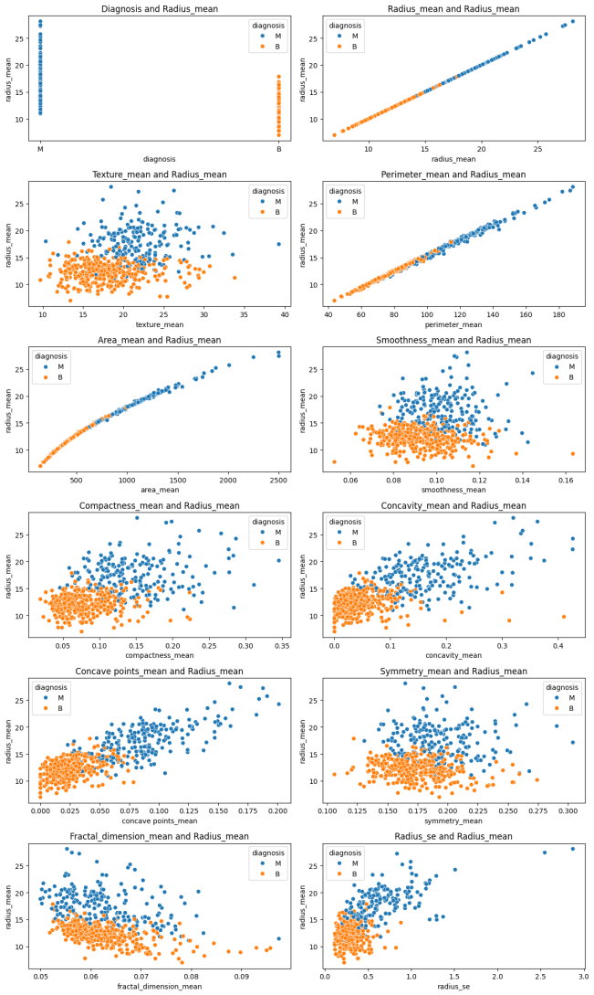

Slide 13
Model Evaluation:
The models were evaluated using several performance metrics, including accuracy, F2 score, F1 score, recall, and confusion matrix.
Random Forest emerged as one of the best models for predicting breast cancer, achieving high performance across all metric

Slide 14
Final Thoughts:
This project successfully demonstrates how machine learning techniques, combined with careful data preprocessing and optimization, can be used to predict breast cancer.
Future improvements can include experimenting with other machine learning algorithms, utilizing cross-validation to ensure robustness, and exploring more advanced feature engineering techniques.

Slide 15
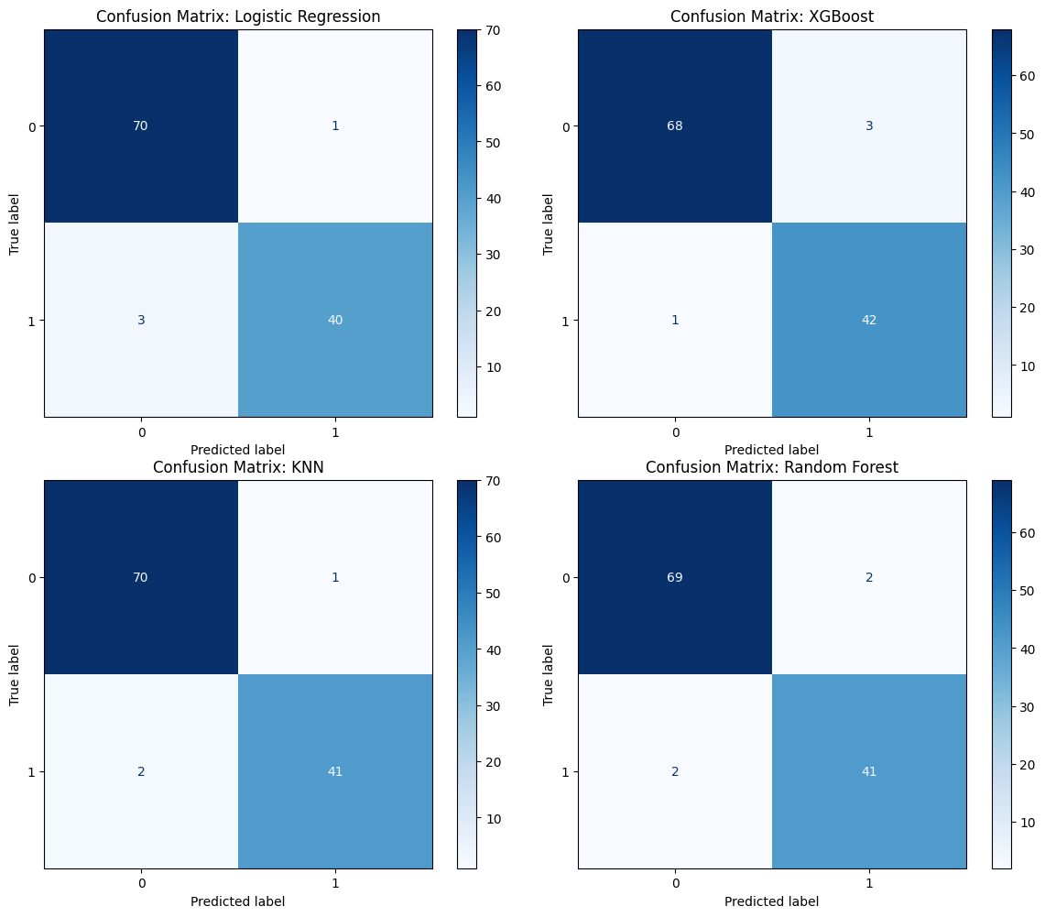

Slide 16
Future Work
Exploring Other Machine Learning Algoithms
Cross-Validation
Feature Engineering
Addressing Class Imbalance More Effectively
Hyper parameter Tuning
Expanding the Dataset
Real-time Prediction System
Comparison with Clinical Methods
Ethical Considerations

